Slide 1


NoSQL Data Management
MODULE 3-
Key-Value Stores and Map-Reduce Framework
Department of Computer Science Engineering
School of Engineering

Slide 2
Module 3 : Key-Value Stores and Map-Reduce Framework
Map-Reduce, Basic Map-Reduce, Partitioning and Combining, Composing Map-Reduce Calculations, A Two Stage Map-Reduce Example, Incremental Map-Reduce. Key-Value Databases, What Is a Key-Value Store, Key-Value Store Features, Consistency, Transactions, Query Features, Structure of Data, Scaling, Suitable Use Cases, Storing Session Information, User Profiles, Preference, Shopping Cart Data, When Not to Use, Relationships among Data, Multi operation Transactions, Query by Data, Operations by Sets.

Slide 3
Understanding Map-Reduce
How Computers Work Together to Handle Big Data

Slide 4
Why Do We Need Map-Reduce?
When we have a lot of data, one computer can’t handle it all.
So we use many computers (a cluster) to share the work.
Map-Reduce helps make these computers work together efficiently.

Slide 5
What Is Map-Reduce?
Map-Reduce is a method used by big companies like Google to handle huge amounts of data.
It has two main parts:
1. Map – Break the big job into small parts.
2. Reduce – Combine all the small results into one final answer.
Example: Everyone counts their apples (Map), and the teacher adds them up (Reduce).

Slide 6
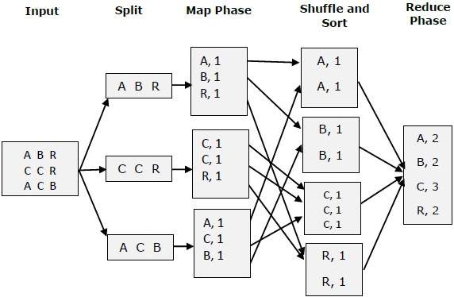
Process of MAP REDUCE

Slide 7
Step 1: Map (Divide and Work in Parallel)
Each computer takes one small piece of data (like an order record).
It looks for key information like product name, price, and quantity.
It sends this as a key-value pair such as tea → {price: $26, quantity: 8}.

Slide 8
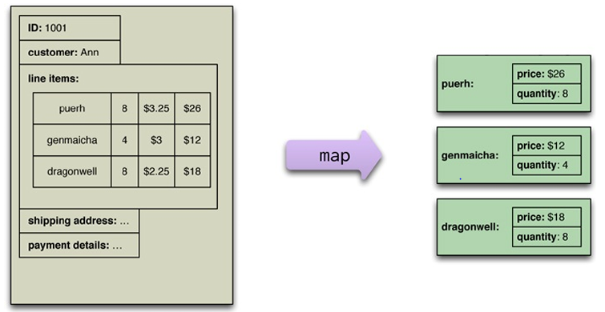

Slide 9
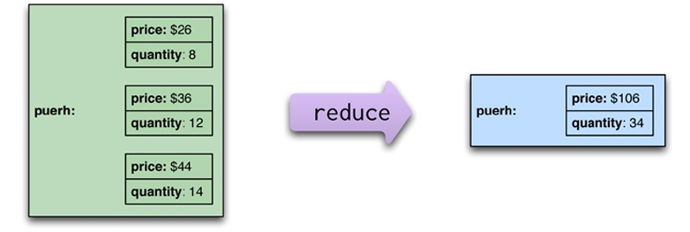
Step 2: Reduce (Combine the Results)
The Reduce function collects all pairs with the same key (same product).
It adds up all their prices and quantities to get the total.
Example: Prices = $26, $36, $44 → Total $106; Quantities = 8, 12, 14 → Total 34.

Slide 10
How It Works Together
1. Data is stored on many computers.
2. Each runs the Map function on its data.
3. Results go to a central computer for the Reduce function.
4. Final combined result is obtained efficiently!

Slide 11
Real-Life Example – Counting YouTube Views
Each computer counts video views in one region (Map).
All results are added up to find total global views (Reduce).
This helps count billions of views quickly!

Slide 12
Summary
Map: Divide big data into smaller parts and process them in parallel.
Reduce: Combine all results into one final output.
Map-Reduce helps computers work together efficiently!

Slide 13
Understanding Map-Reduce
Partitioning, Combining, and Reducing Made Easy

Slide 14
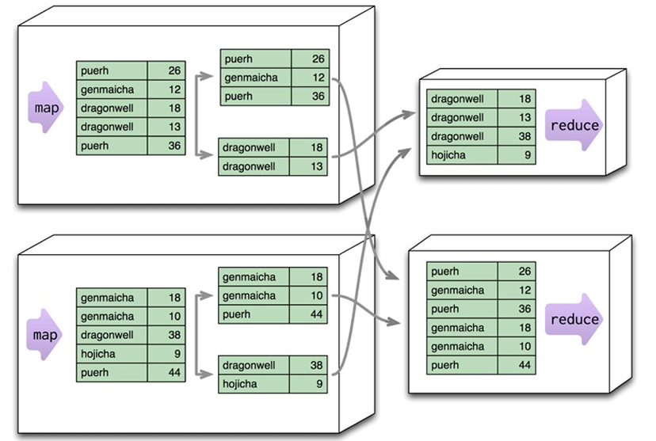
Example of Reduce

Slide 15
Map Step (Splitting Work)
Each mapper processes a portion of this input data (like dividing work among multiple computers).
Mapper 1 might process:
puerh 26
genmaicha 12
dragonwell 18
dragonwell 13
puerh 36
Mapper 2 might process:
genmaicha 18
genmaicha 10
dragonwell 38
hojicha 9
puerh 44

Slide 16
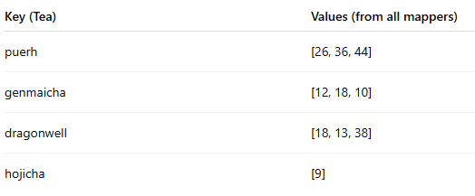
Shuffle & Sort Step (Grouping by Key)
Now, the MapReduce system automatically groups together all pairs with the same key (tea name), no matter which mapper they came from.
So all puerh values go together, all dragonwell values go together, etc.
It rearranges them like this:

Slide 17
Reduce Step (Combining / Aggregating)
Each reducer now gets one group of items (one tea type) and processes it.
For example:
Reducer 1 gets all puerh values and combines them → (26 + 36 + 44) = 106
Reducer 2 gets all dragonwell values → (18 + 13 + 38) = 69
Reducer 3 gets all genmaicha values → (12 + 18 + 10) = 40
Reducer 4 gets all hojicha values → (9) = 9
After reduction, you have one summarized result per tea:
puerh 106
dragonwell 69
genmaicha 40
hojicha 9

Slide 18
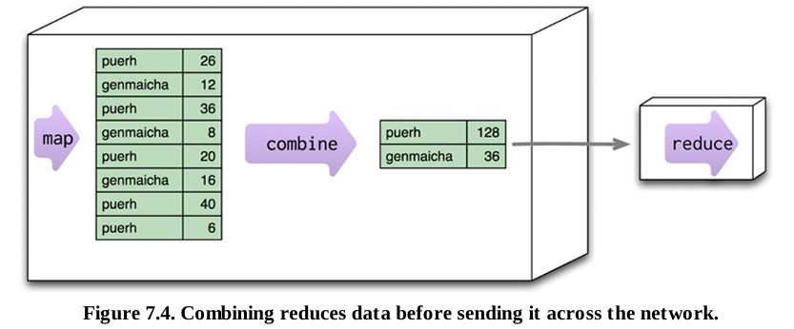
Combining
• After mapping, we may have repeated data for the same tea.
• Instead of sending all data to reduce, we combine locally first.• Example:
puerh = 26 + 36 + 20 + 40+6 = 128
genmaicha = 12 + 8 + 16 = 36
🎯 Combining reduces data transfer and saves time.

Slide 19
Combining + Partitioning Together

Slide 20
Combining + Partitioning Together
Each mapper:
Maps data
Combines totals
Sends smaller results to reducers
Reducers finish the final totals.
Result: Less data movement + faster processing.

Slide 21
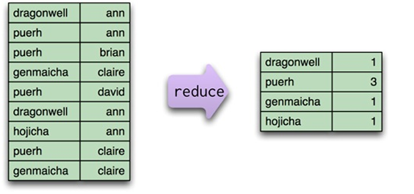
Non-Combinable Reducers
Some reducers cannot combine early.
Example: Counting unique customers per tea.
Map step: (tea, customer)
Reduce step: count unique customers.
Combining early may lose uniqueness info.

Slide 22
Summary
✅ Map – Breaks data into small pieces.
✅ Partition – Divides work by key.
✅ Combine – Reduces repeated data.
✅ Reduce – Produces final result.
💡 Goal: Process big data quickly and efficiently.

Slide 23
Composing Map-Reduce Calculations

Slide 24
How Map-Reduce Works
Map: Operates on each input record independently.
Reduce: Works on grouped results of the same key.
Helps in aggregating, counting, or summarizing data.

Slide 25
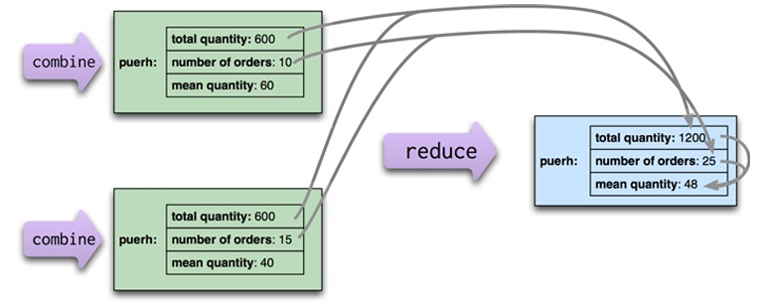
Calculating Averages

Slide 26
Calculating Averages
Averages are not directly composable.
To calculate averages:
Combine total sum and count first.
Then compute average = total sum / count.

Slide 27
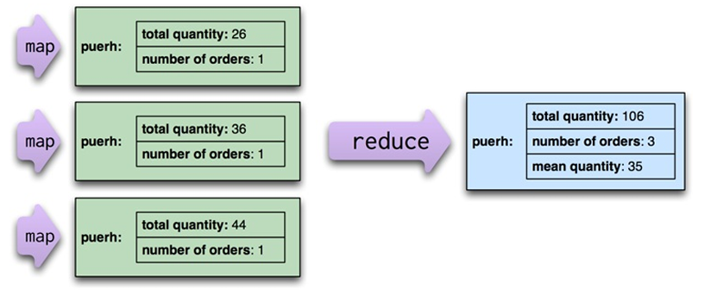
Counting with Map-Reduce
Each Map emits a count of 1 per record.
Reduce step sums these counts for total results.

Slide 28
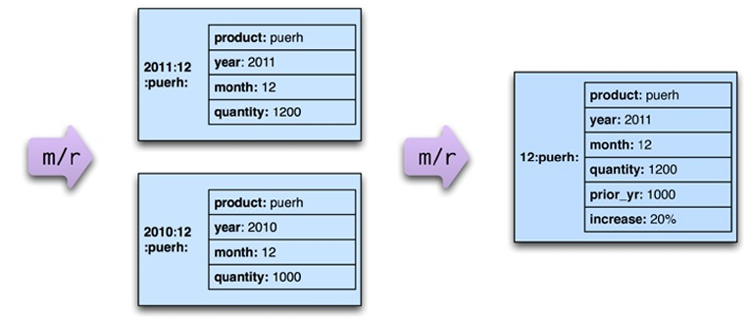
Two-Stage Map-Reduce Example

Slide 29
Two-Stage Map-Reduce Example
Used to compare sales of products year-over-year.
Step 1: Aggregate product sales by month.
Step 2: Compare monthly results between years.

Slide 30
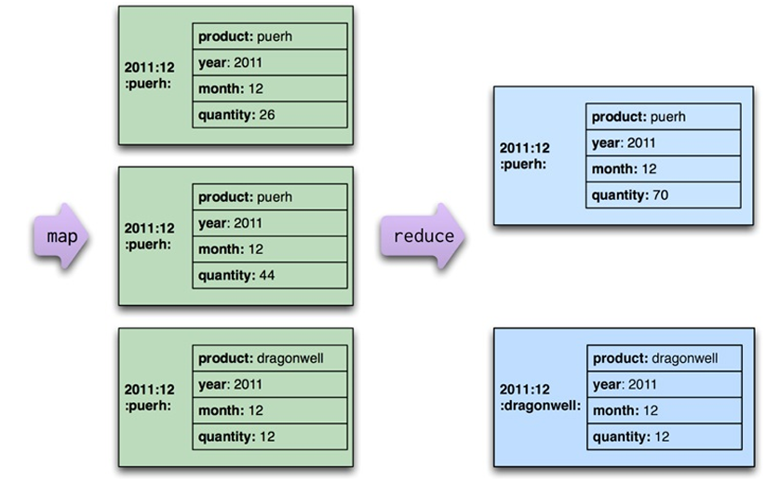
Stage 1 – Monthly Product Sales

Slide 31
Stage 1 – Monthly Product Sales
Reads original order records.
Outputs key-value pairs for sales of each product per month.

Slide 32
Stage 2 – Year Comparison
Maps current and prior year quantities.
2011 → Current year
2010 → Prior year
Earlier years are ignored.

Slide 33
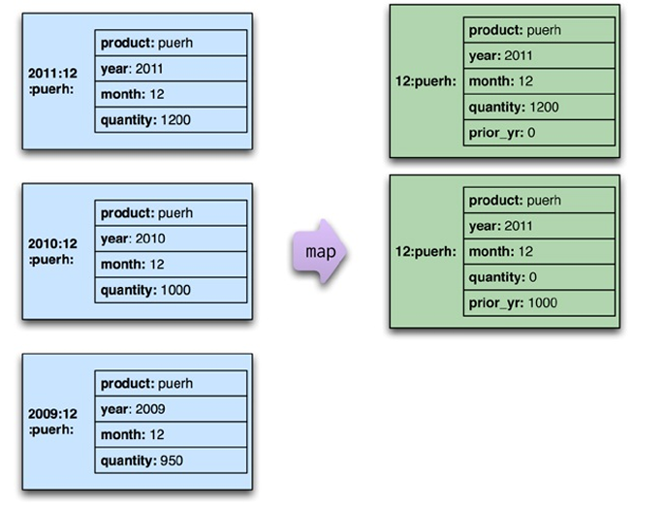
Stage 2 – Year Comparison

Slide 34
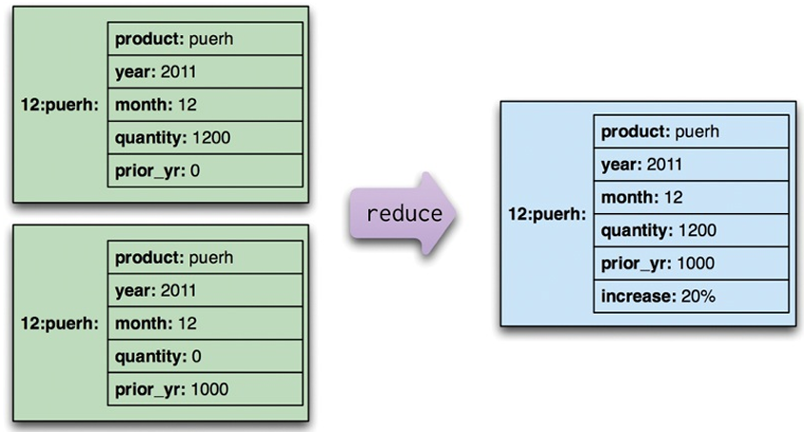
Reduce Step – Merging Records
Reduce merges records by summing quantities.
Computes percentage increase or decrease between years.

Slide 35
Why Multi-Stage Map-Reduce?
Easier to write and debug small steps.
Enables reuse of intermediate results.
Saves time in programming and execution.

Slide 36
Incremental Map-Reduce
Allows updates without reprocessing all data.
Maps can be rerun only for changed inputs.
Reduce can be optimized if partitions are unchanged.
Supports additive updates efficiently.

Slide 37
Tools for Map-Reduce
Hadoop – Open-source Map-Reduce system.
Apache Pig – High-level scripting for Hadoop.
Apache Hive – SQL-like syntax for Map-Reduce.
Used widely for large-scale data processing.

Slide 38
Key Takeaways
Map-Reduce simplifies large-scale parallel computations.
Decomposing steps increases clarity and reusability.
Incremental and composable Map-Reduce make data pipelines efficient.

Slide 39
Key-Value Databases (Riak Example)
Understanding structure, features, and use cases of Key-Value stores

Slide 40
What is a Key-Value Store?
A simple NoSQL database using key-value pairs
Acts like a hash table: {Key → Value}
Used for high-speed primary key access
Example systems: Riak, Redis, DynamoDB, Memcached, Berkeley DB
Applications store and retrieve data via keys only

Slide 41
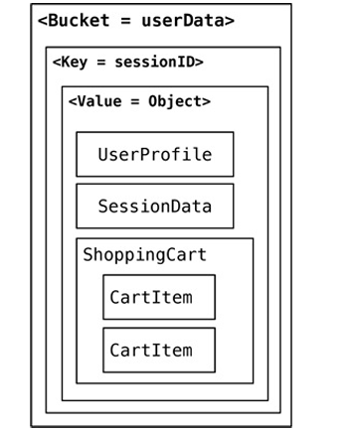
Structure of Data in Key-Value Stores
• Data stored as Key-Value pairs
• Value can be any blob (text, JSON, XML, binary)
• Example structures in Riak (right image)

Slide 42
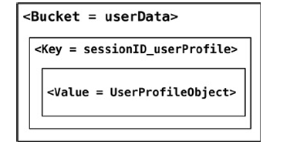
Alternate Key Design
• Avoids storing multiple object types in one bucket
Appends object name to key (e.g., sessionID_userProfile)
Allows retrieval of individual objects easily

Slide 43
Features of Key-Value Stores
• Consistency: Eventual consistency using replication
• Transactions: Based on quorum (N, R, W values)
Query: Retrieve only by key
Structure: Value can be any format
Scaling: Achieved through sharding and replication

Slide 44
Suitable Use Cases
Session Information storage
User Profiles and Preferences
Shopping Cart Data
These use cases benefit from fast access and single-key retrieval.

Slide 45
When Not to Use Key-Value Stores
When data relationships are important
When multi-key transactions are needed
When queries on value fields are required
When set-based or multi-record operations are needed

Slide 46
Summary
Key-Value stores are the simplest NoSQL systems
Provide high scalability and performance
Ideal for simple lookups, sessions, and caching
Not suitable for relational or complex query scenarios

Slide 47


